Slide 1
Introduction to Mendeley
John Q. Doe
Job title
johnqdoe@example.com
Notes:
Hello and welcome to this Mendeley presentation. Today I’m going to give you an introduction to Mendeley, to help you get started. Hopefully you’ve downloaded and taken a look at Mendeley already, but if not, that’s okay too. I’ll walk you through the majority of the features we have to offer.

Slide 2
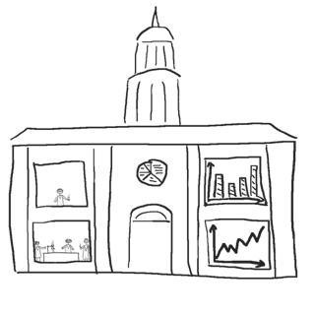
What is Mendeley?
Organize your documents + references
Collaborate by joining + creating groups
Discover statistics + recommendations
Stay up to date + Learn more
Notes:
This is a general overview of what we’ll try to go over in this presentation. I’ll start off by explaining what is Mendeley. It is a free reference manager and academic social network that can help you organize your documents and references. Mendeley helps you collaborate with your fellow researchers online by joining and working together in groups. I will also show you how Mendeley can provide you with readership statistics and recommendations, and how you can stay up to date and learn more.

Slide 3
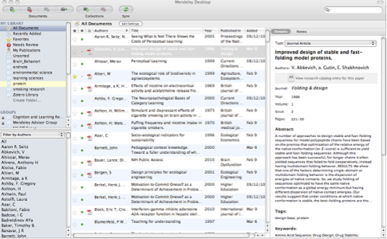
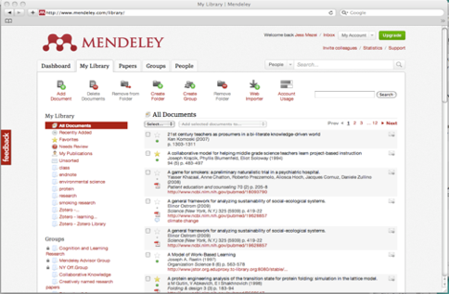
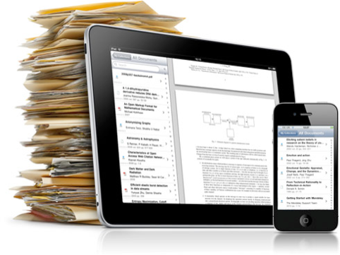
What is Mendeley?
Free Academic Software
Cross-Platform (Win/Mac/Linux)
All Major Browsers
Mobile
Desktop
Web
Notes:
So, what is Mendeley exactly? Mendeley is free academic software that is available on all major platforms and in all modern browsers. That means you can use Mendeley on your Mac, on your PC, or in Linux. Mendeley offers you a desktop application that you run on your computer, a web library for when you’re not at your own computer, and an iOS application, so you can work on the go. We’ll see how the desktop and web components work together in a couple of slides.

Slide 4
Organize
Setting Up Your Library
Notes:
First thing you need to do is visit mendeley.com, sign up and download the application. Once ready, it’s time for you to start setting up your Mendeley library.

Slide 5
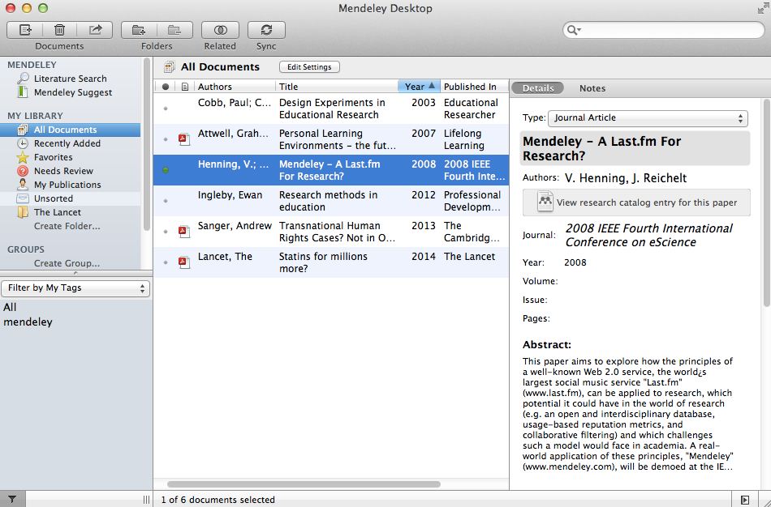
Mendeley Desktop overview
Notes:
This is what your Desktop Library looks like. The desktop is divided into three panes. They follow a workflow hierarchy from left-to-right. Any activity in the left pane affects the display of content in the center pane. And any activity in the center pane is reflected in the right-hand pane, the document details pane.

Slide 6
Your library structure
Notes:
The left hand pane is your top level library overview. There are a few default folders or collections. These include All Documents, Recently added, favorites, Needs review, My publications and unsorted. You can create your own folders and subfolders. You will also see other options in this panel that relate to groups that you have either created or joined. I’ll get to the groups and collaboration aspects of Mendeley later on in this presentation.

Slide 7
Your references
Notes:
The center pane shows the reference list for whichever folder you selected in the left hand panel. There are a few functional elements here that I’ll explain shortly.

Slide 8
Document details
Notes:
The right-hand side pane is where you will see the document details related to the references selected in the middle pane.

Slide 9
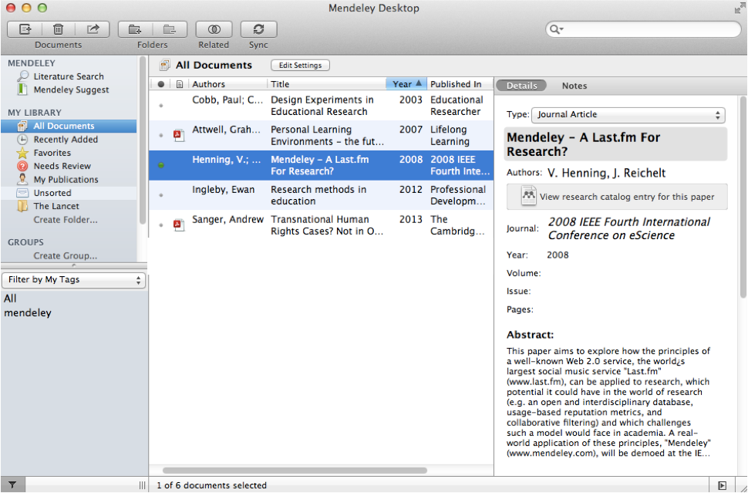
Adding Documents
Notes:
Mendeley makes it easy to add documents. The simplest way is to drag and drop a file right into Mendeley.

Slide 10
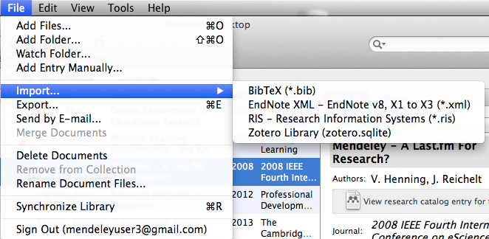
Adding Documents
Import your references from
BibTex, Endnote, RIS or Zotero
Select a file or folder to
add from your computer
Watch a folder
Add references
manually
Notes:
There are actually quite a few different ways of adding documents to your library besides drag and drop. You can use the File menu and select from a few options. You can select a file or folder to add from your computer, or you can define a watch a folder. A watch folder is a folder or multiple folders that you define on your computer to keep an eye on. What this means is that whenever a new PDF is added to this folder, Mendeley will automatically know that it’s new and import it for you.
If you like, you could add references manually instead. Select the option, pick the type of document and fill in the details.
If you’re already using another reference manager, such as EndNote, RefWorks or Zotero, you can import your references directly into Mendeley. Simply export your library from those tools into a standard format such as RIS or BibTeX and Mendeley will have no problem importing the library.

Slide 11
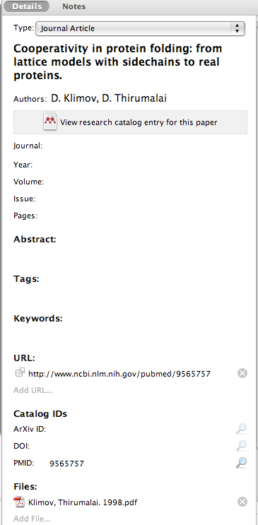
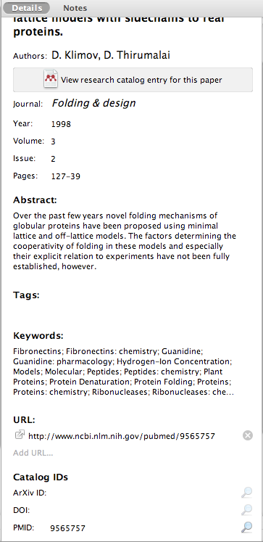
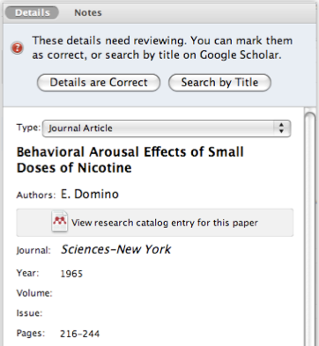
Document Details Lookup
Look up documents by title on Google Scholar if they are flagged for review
Enter the DOI, PubMed, or ArXiv ID and click on the magnifying glass to start lookup
Mendeley adds missing info automatically
Notes:
Keeping your document details is super important, therefore I thought it would be a good idea to see how Mendeley takes care of most of the hard work for you.
When you add a document to your library, Mendeley will do its best to import all the relevant data from the article you added but sometimes data may be missing. Fortunately, that’s easy to fix. Simply enter the DOI, PubMed or ArXiv ID and click the magnifying glass to have Mendeley perform an online search for the correct information. Mendeley will then add everything it found automatically. Sometimes Mendeley will flag a document for review, which means that some of the information may be missing or incomplete. At this point you can select to have Mendeley search for document details using Google Scholar to fill in missing fields. Keep in mind that you can edit any of these fields manually and if you make a mistake, simply undo the changes.

Slide 12
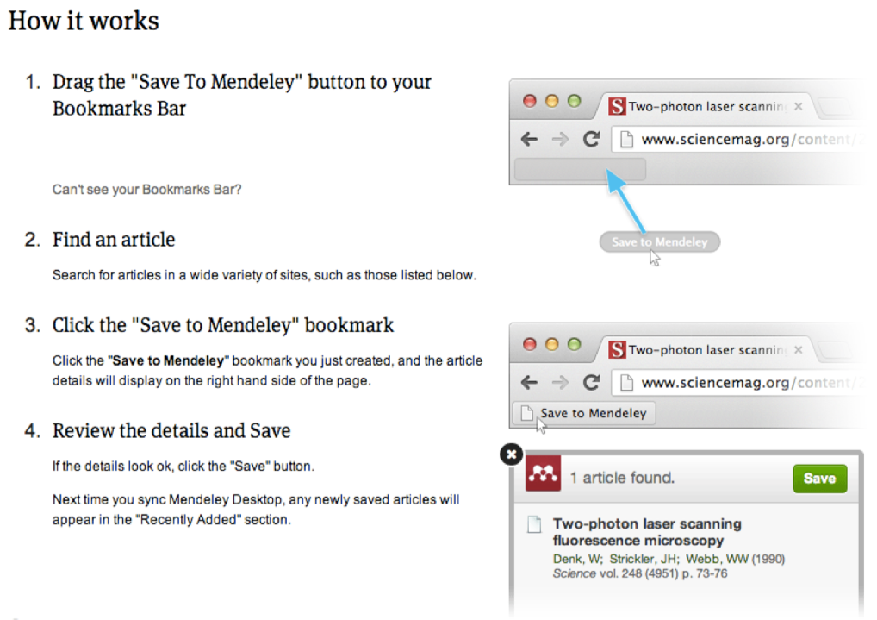
Web Importer Save research while browsing online
Notes:
As mentioned before, the Mendeley Web importer is another way of adding references to your library. In fact, it’s an invaluable tool when performing literature review or searching various databases for articles of interest. If you visit mendeley.com/import, you will find instructions on how to install the bookmarklet in your browser and also information on all the databases that our importer currently supports. That bookmark will tell Mendeley everything it needs to know to add an article to your library. I’ll show you what it looks like in action.

Slide 13
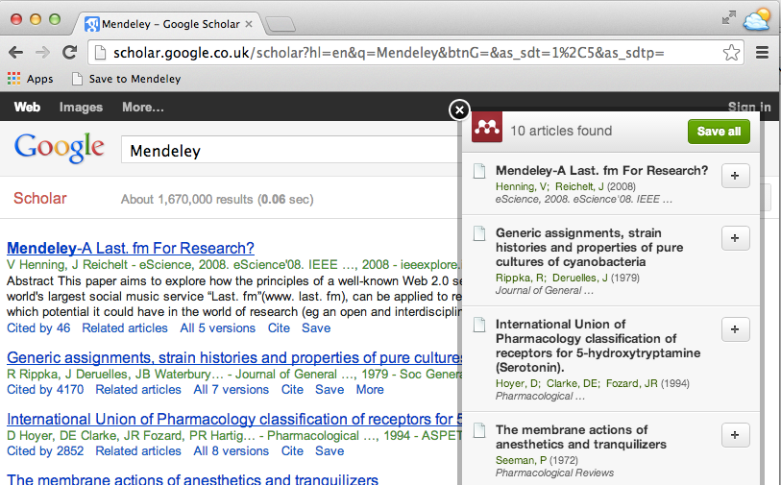
Using the Web Importer
Click ‘Save to Mendeley’ to import references from your search results
Select an article and import the reference to your library in one click.
Notes:
Any time you come across an interesting article online, or when you do a search on Google Scholar or one of our many partner sites, you can save this article to your library by clicking the browser bookmark ‘Save to Mendeley’. A modal window will then pop up, like the one you see on the right. Select any articles you’d like to import, and then click the green button to save them. Done! If you have access to the article via your institutional network, PDF icons will indicate that the actual files are accessible and these will be saved to your library automatically along with the references.

Slide 14
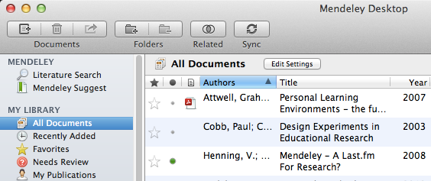
Sync
Sync your library to the Mendeley Cloud to access it anywhere & read on all your devices
Mendeley backs up your library online
Access your articles anywhere
Get customized suggestions and add them to your library
Notes:
Unlike many other reference managers, Mendeley securely syncs your library between devices and backs it up online. That means that Mendeley Desktop and Mendeley Web update each other, so you will always have access to the most recent versions of your articles and notes, even if you are not at your own computer. Your library is 100% secure, and is not visible to anyone else, but syncing does allow Mendeley to analyze your library anonymously, so it can make customized suggestions for you on request. This way you can discover other research in your field, and see which articles are the most popular right now.

Slide 15
Organize
Managing Your Library
Notes:
We’ve just gone over how you add references and documents to your library. Let’s talk about how you can manage the articles that are already in your library.

Slide 16
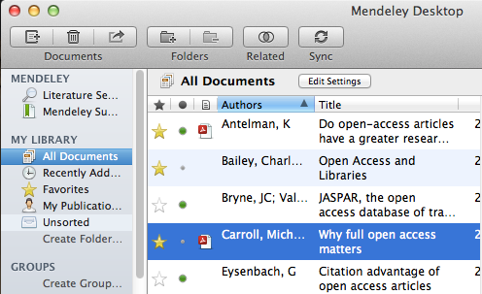
Manage Your Library
Open attached PDF files in integrated viewer
Star favorites
Mark as read/unread
Create category folders
See what type of document is attached
(.pdf, .ppt, .docx, excel, etc.)
Notes:
We’re back to your Library View now. In Mendeley desktop, besides the default folders or collections, you can create your own folders and subfolders to organize your articles. You can mark documents as read or unread by clicking the little green button next to the article. You can also star your favorite papers. You can attach different types of documents to a reference. If you see a little pdf icon next to the title, that means the full document is available for you to view in Mendeley’s PDF viewer. I’ll show you how to do that in a minute.

Slide 17
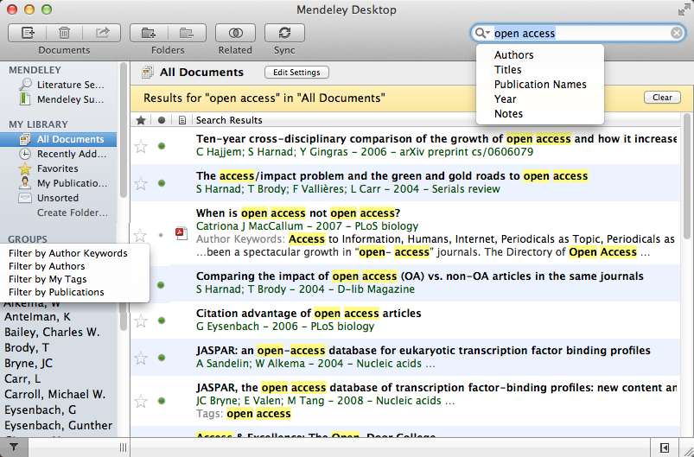
Search Your Documents
Full text search, or filter your results
Filter your
documents by
author, tag,
publication,
or keyword
Notes:
Once you have a lot of documents in your library, you may want to try Mendeley’s search functionality, which you can see here at the top right.
Mendeley extracts and indexes the full-text of your articles, so this search box looks across the full text! Type in words and see results start showing up in real-time. You can filter down your search criteria by selecting to search only the Author, Title, Publication Name, Year, or Notes.
This search box is context specific, meaning that it will search only across documents that are within the currently selected folder on the left-hand side.
If you want to further filter down the results, you can find some filter options on the bottom left pane.

Slide 18
PDF Viewer
Highlight and Annotate Documents
Notes:
We’ve just finished talking about how to set up your reference library and how to go about organizing and finding the references. Now it’s time to read the articles. Mendeley has a built-in PDF viewer which allows you to open multiple documents at a time, and add annotations and highlights to your PDFs.

Slide 19
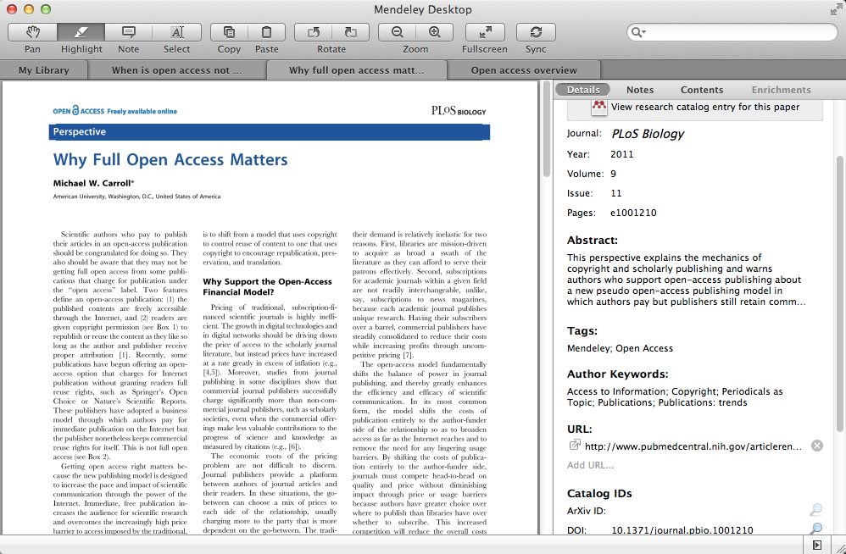
The PDF Viewer
Notes:
This is what your PDF viewer looks like. As you can see in the top bar, you can have multiple files open at one time in Mendeley, so you can read and annotate multiple documents. You’ll find the normal tools associated with PDF readers. Pan, highlight, select, zoom, etc. Full screen mode is a great feature that provides minimal distraction while reading. Mendeley’s PDF viewer will remember which page you were on, so that the next time you return to that article, you don’t waste time searching where you left off.

Slide 20
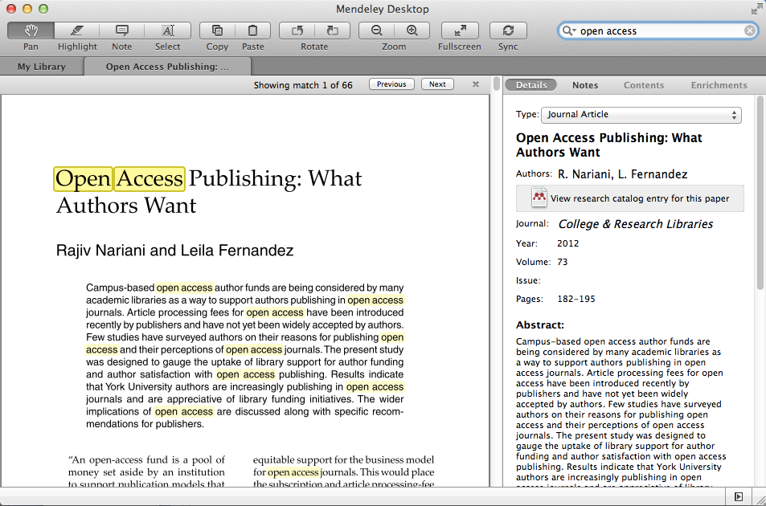
Read and Work in the PDF Viewer
Notes:
As I mentioned earlier on, the search box in the top right corner is context specific. In this case, the search box would only search across the full text of the research article you are currently reading by highlighting the search terms and allowing you to cycle through them.

Slide 21
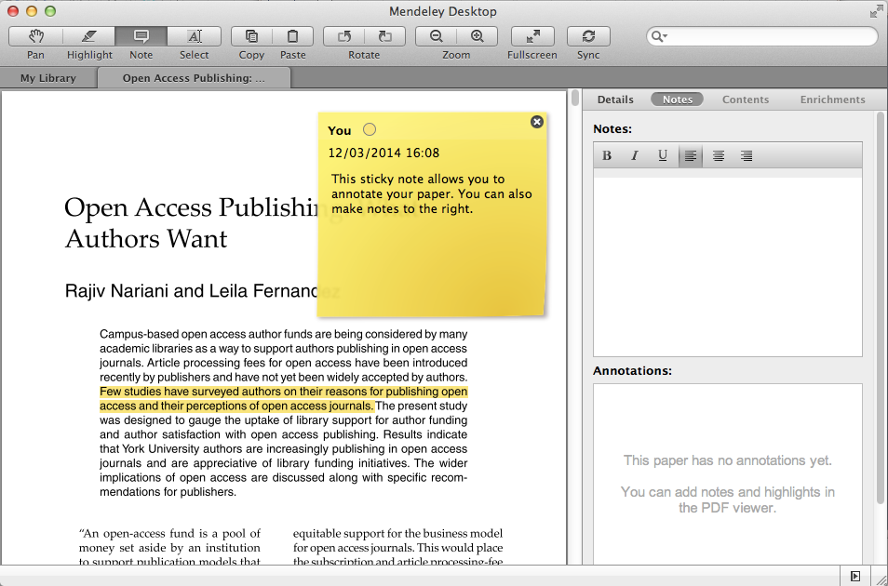
Annotate and Highlight
Notes:
Mendeley’s built-in PDF viewer lets you highlight text and annotate the articles by adding sticky notes. You can also add article-wide notes in the right hand column. The text in these document-wide notes are searchable using the top-right corner search box.

Slide 22
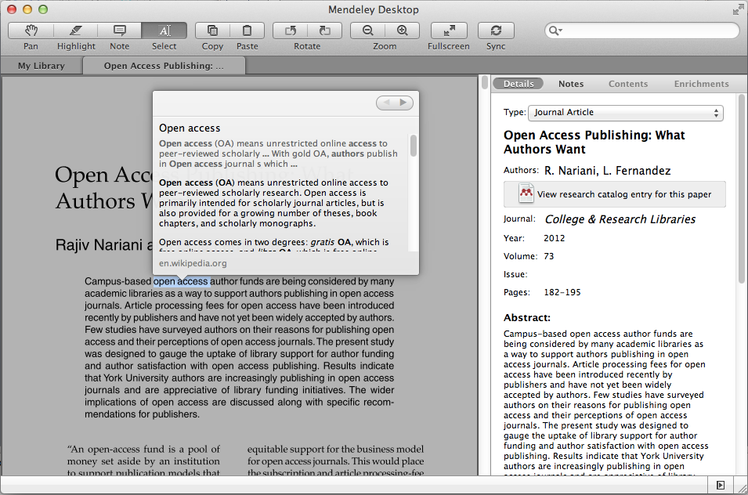
Look Up Term Definitions
Notes:
Here’s an interesting feature that may come in handy from time to time. If you come across any words or terms you haven’t heard before, simply right click and choose ‘Define’ to look it up. Mendeley will do it’s best to retrieve definitions and explanations for you.

Slide 23
Cite
Using the Mendeley Citation Plug-In
Notes:
We have gone through the steps of setting up our library, keeping it organized and even reading and annotating the articles. It’s about time we get started on writing our own papers.
Mendeley comes with a built-in citation plugin that will save you time by helping you cite references as you write your manuscripts. No more tedious hours spent checking style guides and manually writing your bibliographies. Mendeley will do all the work for you!

Slide 24
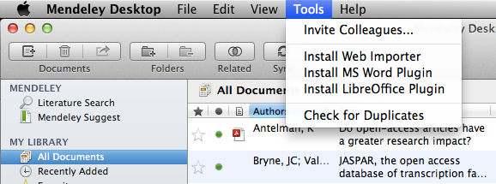
Install the Citation Plug-in
Notes:
We like to make life easier for you, so installing the Citation Plug-in takes only a single step. From Mendeley Desktop (with Word closed!), click ‘Install MS Word Plugin’ and Mendeley will do the rest. This works not only for MS Word, but also for LibreOffice. Now open your word processor to see the plugin. We support MS Office for Windows and Mac and LibreOffice on Win/Mac/Linux.

Slide 25
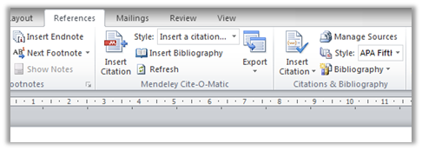
The Citation Tool Bar Appears in Word Automatically
Mac
Windows
Notes:
On a Mac, the plugin looks like a bar that lists the functions of Mendeley. You can move this bar wherever you like, or you can hide it. If it ever accidentally disappears, don’t worry. Go to View, then Toolbars, and click ‘Mendeley Toolbar’ to make it re-appear. In Windows the plugin looks a little bit different, as you can see below. You can find it under the ‘References’ tab and the toolbar is integrated into the ribbon.

Slide 26
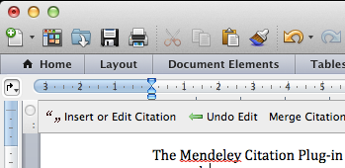
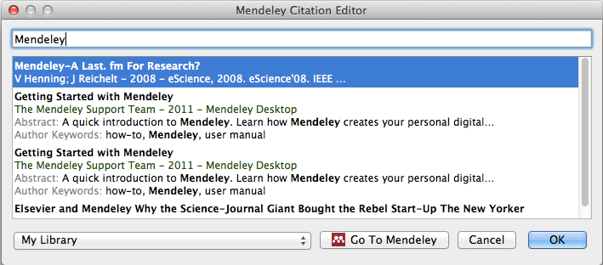
Generate In-Text Citations in Word
Click ‘Insert or Edit Citation’
Search by author, title or year, or select a document from your Mendeley library
3. Select the article or book, and click ‘ok’ to automatically cite that text in Word
Notes:
Now imagine you’re working on your own research in Word. When you’re ready to add a citation to your paragraph, click ‘Insert or Edit Citation’. A new window will pop up. Simply type in the name of the author, part of the title, or the year, and Mendeley will show you a list of matches. You can also click ‘Go to Mendeley’ to pick an article from your library. Now click ‘OK’ to add the citation in Word, and it will appear.

Slide 27
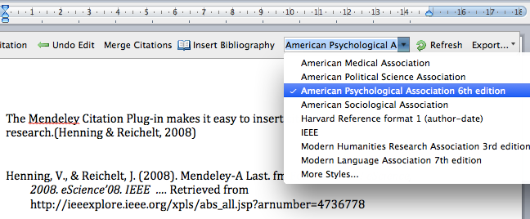
Inserting Your Bibliography
1. Click ‘Insert Bibliography’
2. Choose your style
3. Done!
Notes:
When you have finished your work, and you’re ready to add the bibliography, click ‘Insert bibliography’ in the Mendeley toolbar. Mendeley will then generate your bibliography for you instantly. You know how some journals may ask for different citation styles than others? Well, gone are the days of manually rewriting your bibliography. Change all of your citations and your bibliography with the click of button, by picking a different style from the drop down menu.

Slide 28
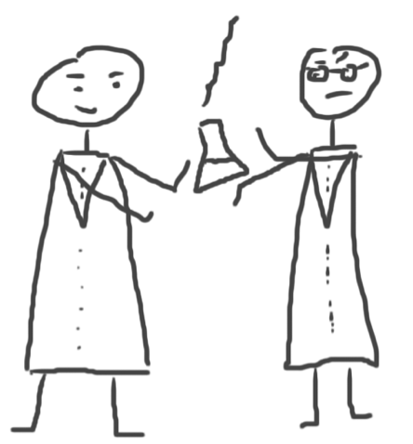
Collaborate
Join and Create Groups to Share References
Notes:
What makes Mendeley unique, is the ways in which you can collaborate with colleagues and friends, and discover new research. Share papers, make notes on the same articles, and meet new researchers in your field. Collaboration is a key component of research.

Slide 29
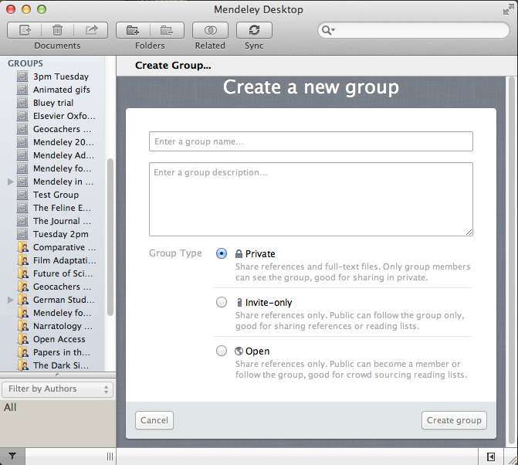
Create Groups
See the groups you created, joined or follow
Add documents to a group by dragging and dropping
Notes:
Mendeley Groups help you connect to people and share references. There are three types of groups: Private, Invitate-Only and Open Public Groups. You can create and manage groups in Mendeley Desktop as well as online at mendeley.com. Add documents to a group by dragging and dropping them into the group folder.

Slide 30
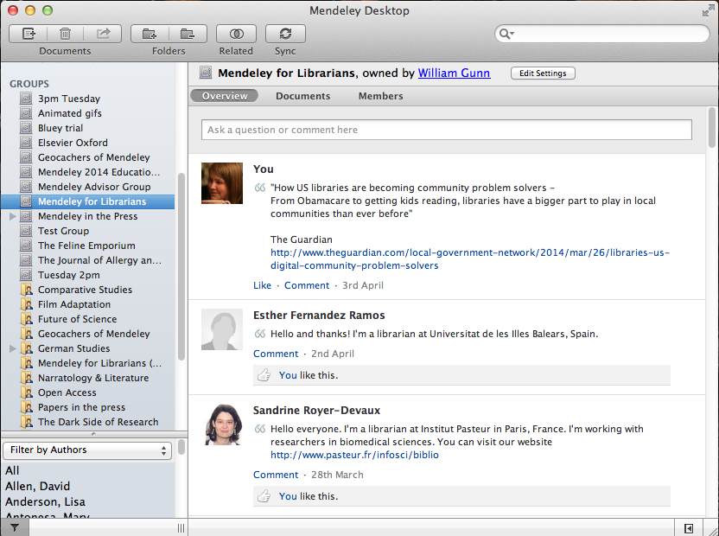
Private Groups
Private groups let you share full text documents with a limited number of members
Nobody outside the group can see the group or its files or members.
Notes:
Private groups are, well, private. They cannot be found on the Mendeley Groups page, and no-one on the network knows they exist or who is in them. Except for the owner and invited members of the group. The owner must invite people to join, and members must accept to join the group. These groups are perfect for collaboration, because you can share full text documents and collaborate on research. You can only invite a limited number of members to join a private group.

Slide 31
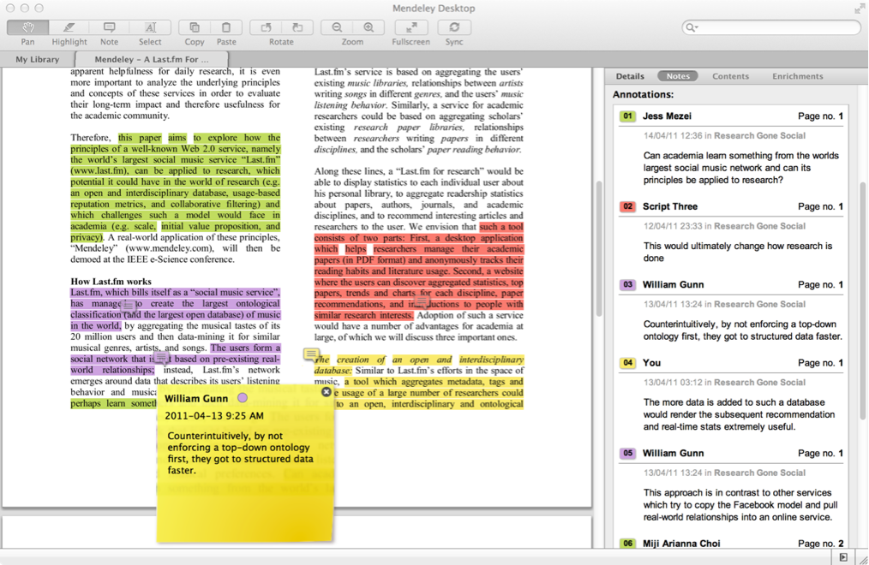
Share Your Papers Collaborate with Your Research Team
Share full-text
documents with members of your private group
Share highlights and annotations
Each group member is assigned a different color for highlighting
Notes:
When you’re a member of a private Mendeley Group, you can view the full text of papers, and collaboratively annotate and highlight documents. Mendeley automatically assigns a different color to each collaborator, so it’s easy to see who highlighted what, and who made which annotation. After you’ve worked on a paper, be sure to click ‘sync’ in your Mendeley library, so that your changes are sent back to the server for your fellow group members to see.

Slide 32
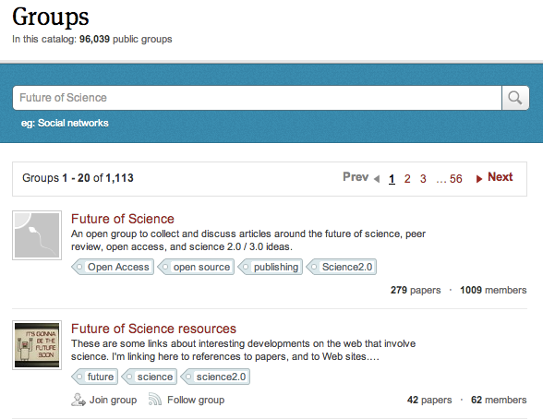
Find Public Groups
Search public groups on Mendeley Web
Notes:
Now looking at the other types of groups, if you go back to our website, you can search the groups page for public groups that interest you. You can also create and manage your groups online. Both invite-only and open public groups are searchable on Mendeley web.

Slide 33
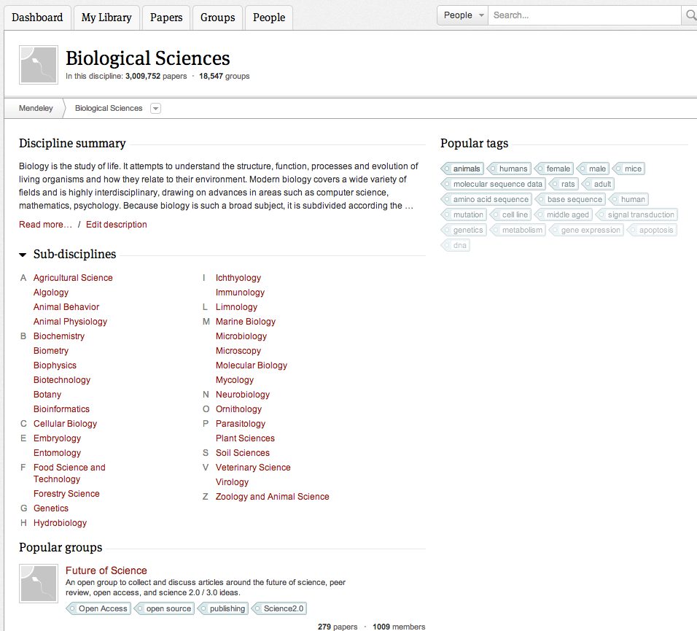
Browse Popular Groups
Browse by discipline to discover new groups
Notes:
Not sure yet what you’re looking for? No problem! Mendeley lets you browse popular groups by discipline, so you can discover new groups you might not have come across before. With over 100,000 public groups created, we’re sure you’ll find something that interests you.

Slide 34
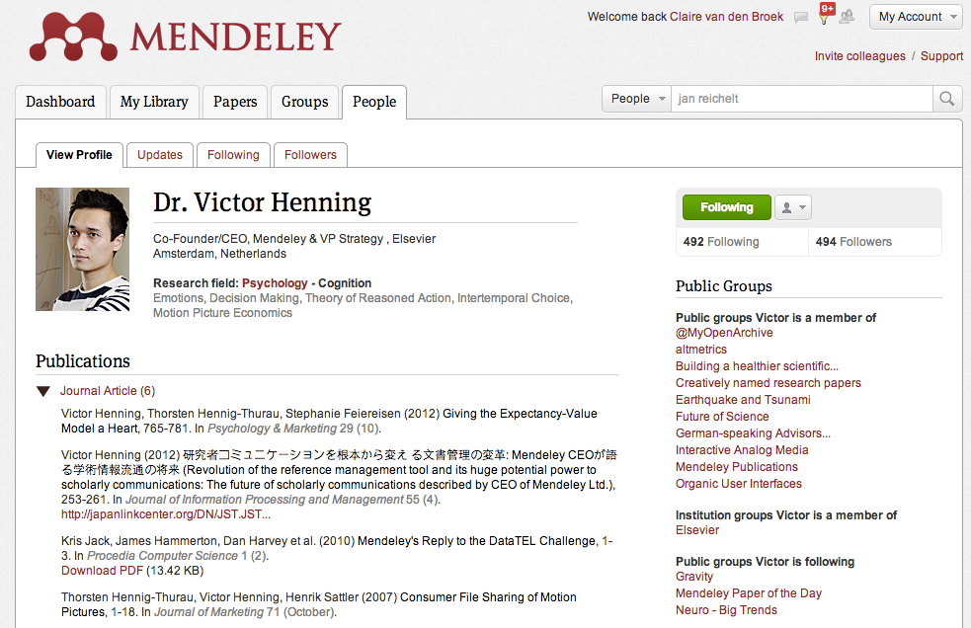
Create your research profile
Connect with colleagues
and join new communities
Share Your Publications
Notes:
When you sign up for your Mendeley account, you are automatically creating a researcher profile on Mendeley Web. This profile allows you to showcase your research, receive statistics on your publications, and connect with other researchers and colleagues, for example by ‘Following’ them on Mendeley. Following other researchers of interest on Mendeley allows you to keep track of their academic developments on Mendeley and enables you to engage and network with like-minded researchers.

Slide 35
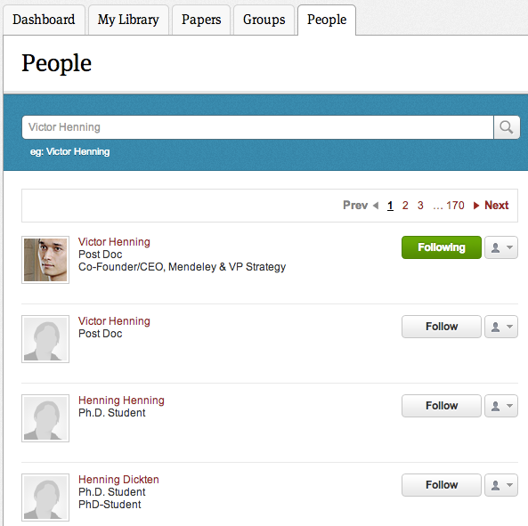
Connect with Colleagues
Search for people and click ‘Follow’ to get regular updates.
Notes:
You can find colleagues on Mendeley by doing a search in the “People” tab on Mendeley Web. You’ll see a list of results that match your search terms. Click ‘Follow’ to get regular updates about their work. You can change your settings so that people have to ask permission before they can follow you. Are your colleagues not on Mendeley yet? Why not send them an invitation, so you can collaborate on documents and share research with one another!

Slide 36
Discover
New Research, Recommendations, and Impact
Notes:
As I mentioned before, Mendeley is a great way to discover new research, get recommendations, and to see the impact of articles on the research community. Let me show you how Mendeley can help!

Slide 37
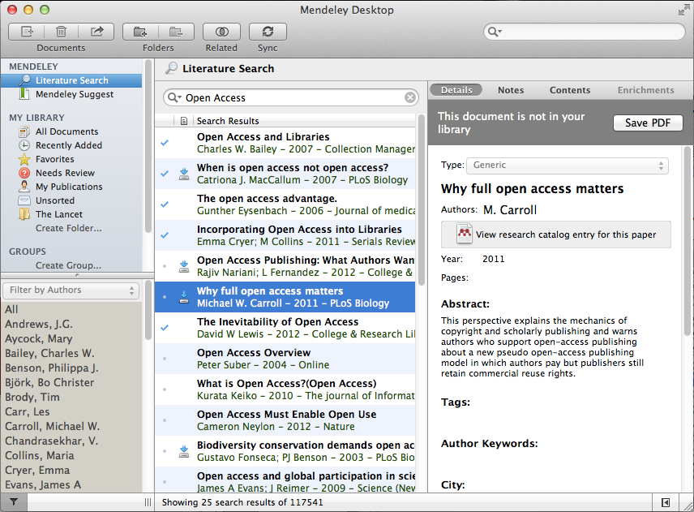
Literature Search
Search the
catalogue
Save new research to your library with one click
If the full text is available, you’ll see a download icon:
Notes:
Mendeley’s research catalog is an ever growing crowd sourced database of metadata anonymously aggregated from all the uploaded documents from all Mendeley users. As such, with over 500 million documents uploaded to Mendeley, the size and breadth of information available in our research catalog is impressive. You can search the research catalog from within Mendeley desktop by selecting the “Literature Search” option in the left-pane. You can easily look at each of the reference results and save those which interest you to your library. If the full-text is available, you’ll notice a small icon indicating that it is downloadable.

Slide 38
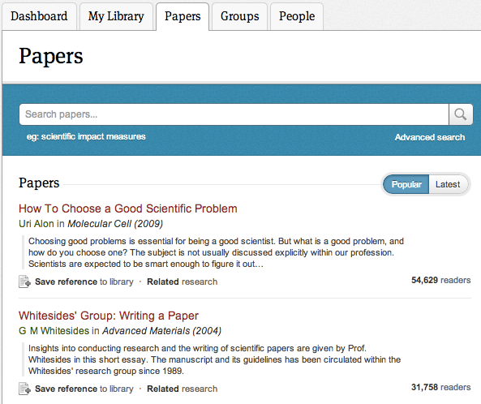
Search the Catalog Online
Conduct advanced searches or browse by discipline
Find new research based on what is popular or the most recently added
Notes:
You can search the catalog online as well, or browse by discipline. You will notice that the search results will indicate the number of Mendeley readers that entry has, giving you a sense of its popularity. The first article listed here in the screenshot, titled ‘How To Choose a Good Scientific Problem’ has been read by more than 50,000 people on Mendeley. Let’s click on that entry and see what the article level view provides us.

Slide 39
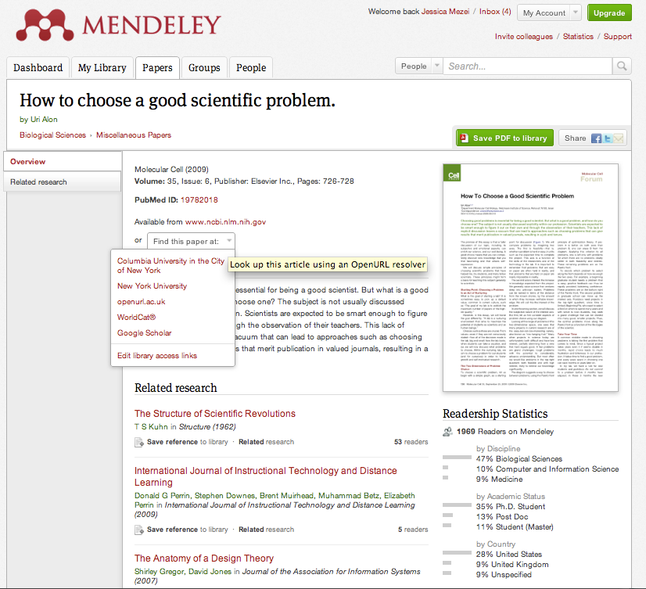
Quickly Add New Research
If the article is freely available, it’s a one-click addition to your library
Or use Open URL to locate the full text
Social statistics help you learn about others using this paper
Notes:
When you click on a paper title on the Mendeley website, you are taken to a page like this, where you can see a pdf preview of the paper if it’s available. Add the article to your library with one click, if it’s freely available. We do our best to partner with publishers to make as many PDFs available as possible, so this option is available for some but not all papers. If you can’t find the full article directly, Mendeley will link to other locations, or help you find it in the various databases to which your institution is subscribed.

Slide 40
Stay in touch
Updates, feedback, resources…
Notes:
We’ve covered a lot of ground in this presentation. Let me just go over a few of the ways that you can keep informed of our current and future developments.

Slide 41
Stay Up-to-Date and Learn More
Get new tips and stay connected by visiting our blog at blog.mendeley.com
Read our guides and watch our tutorial videos
resources.mendeley.com
Notes:
If you’d like to stay up to date with new developments in Mendeley, or if you’d like to learn new tips, you can stay connected by visiting our blog at blog.mendeley.com. If you’d like to learn more about specific features of Mendeley.com, check out our resource center online at resources.mendeley.com. You can also connect with us on Facebook, Twitter, and see our photos on Flickr.

Slide 42
Mendeley “It’s time to change the way we do research”
www.mendeley.com
John Doe, PhD
john.doe@example.com
Notes:
We’ve come to the end of this presentation. I really hope you’re excited about getting started with Mendeley.
Thank you for your attention and welcome to Mendeley!

